Slide 1
Steps To Download And Save The Challan Input File
( .csi file )

Slide 2
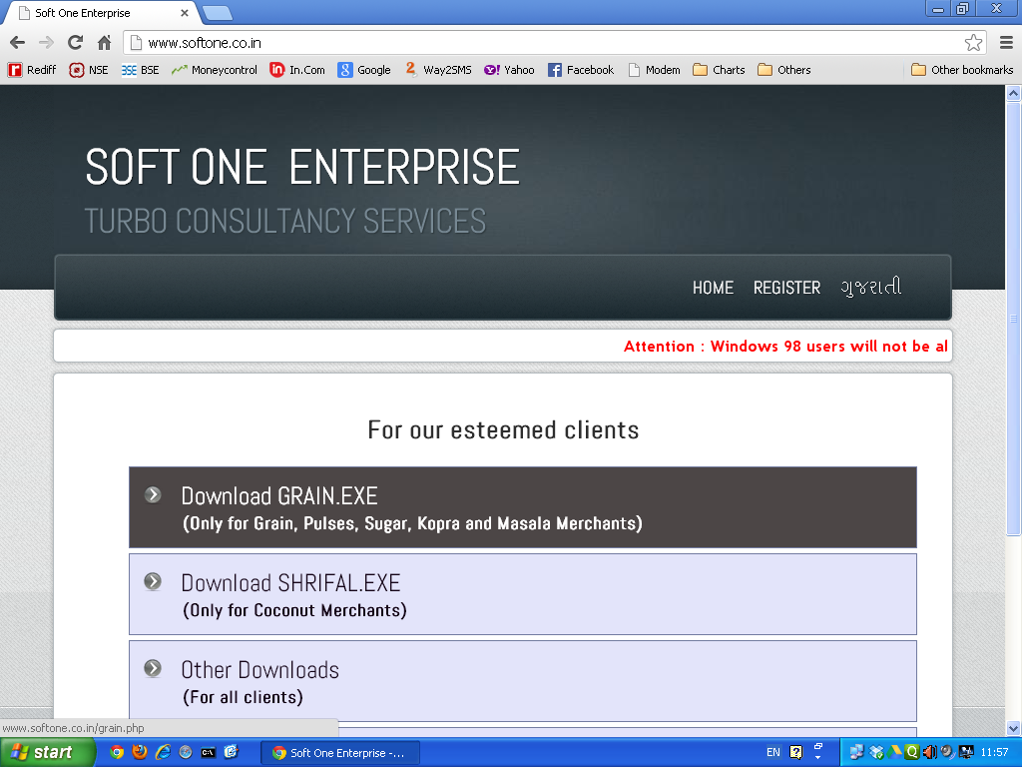
On opening the website,
this screen shall appear.

Slide 3
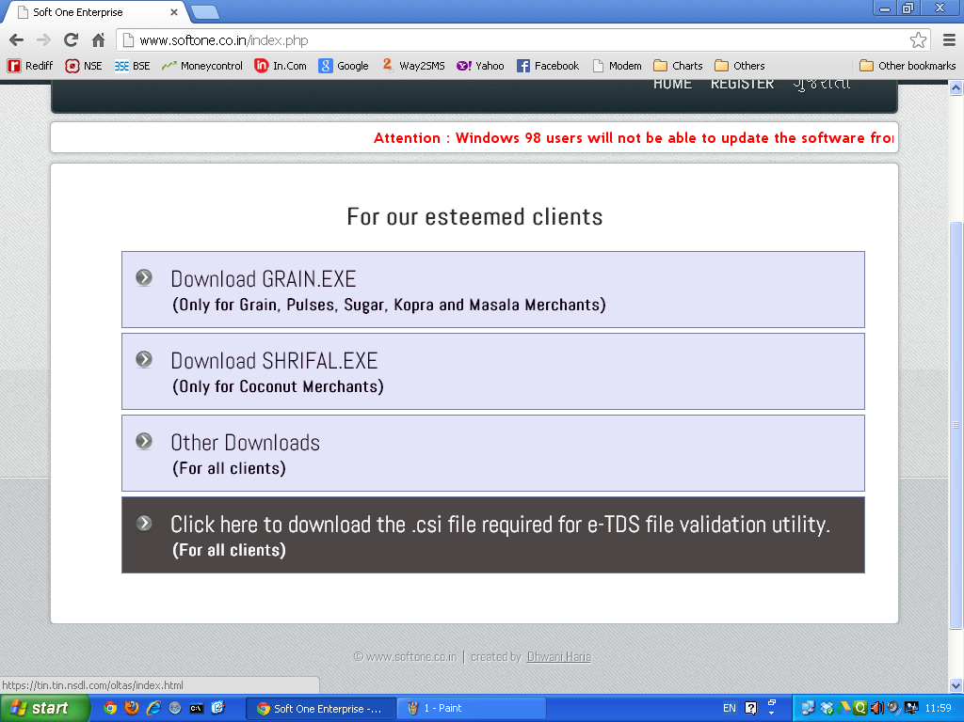
Then, click on this
option.

Slide 4
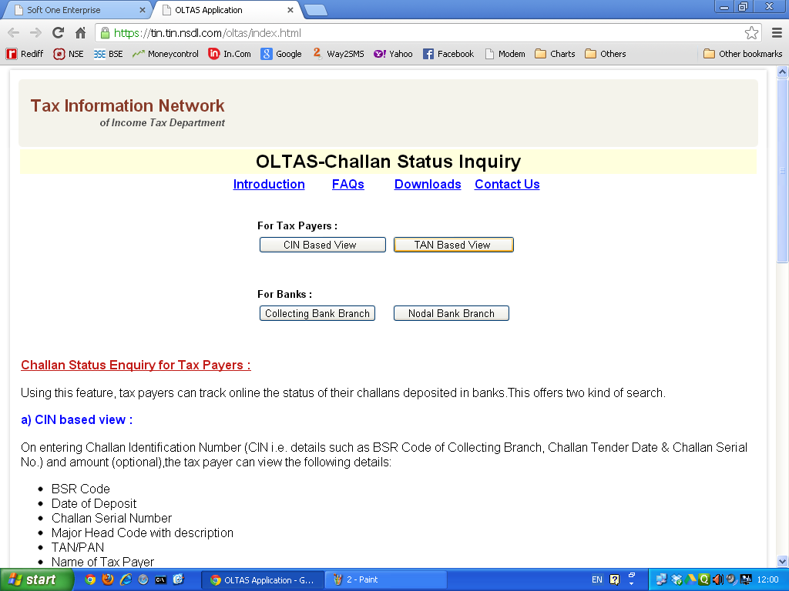
After that,this screen will appear. Then click on this button.

Slide 5
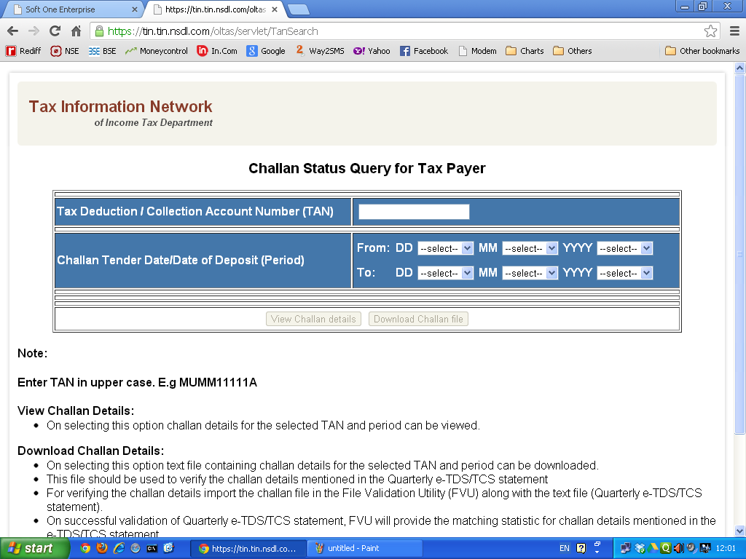
Now you will see this
screen.

Slide 6
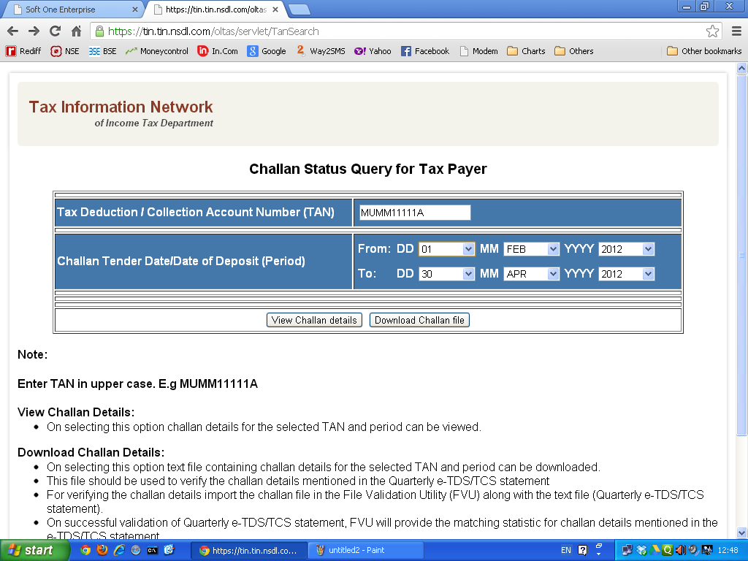
Enter your TAN (in
CAPS) as shown here.

Slide 7
Enter the payment period (NOT THE QUARTER
PERIOD). For example, if for Qtr I, first challan is
paid on 7th May, then that shall be entered in the
"FROM" date. Similarly, if the last challan for Qtr I
is paid on 7th July, then that shall be entered in the
"TO" date.

Slide 8
Now, click on this button to proceed.

Slide 9
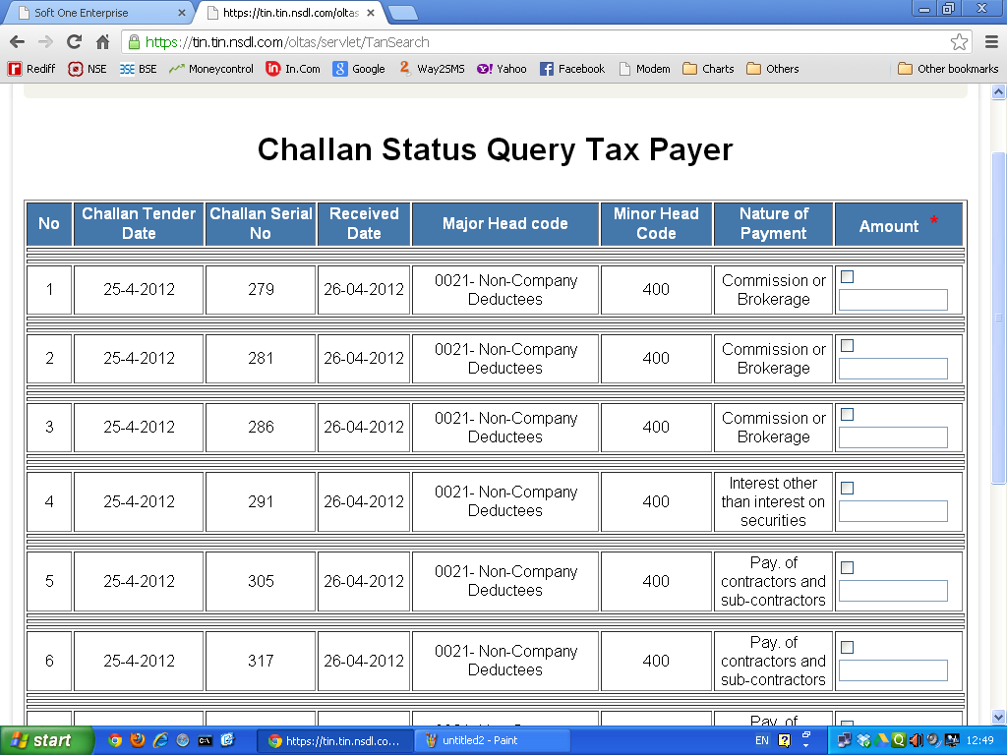
Now, screen similar to this will appear.

Slide 10
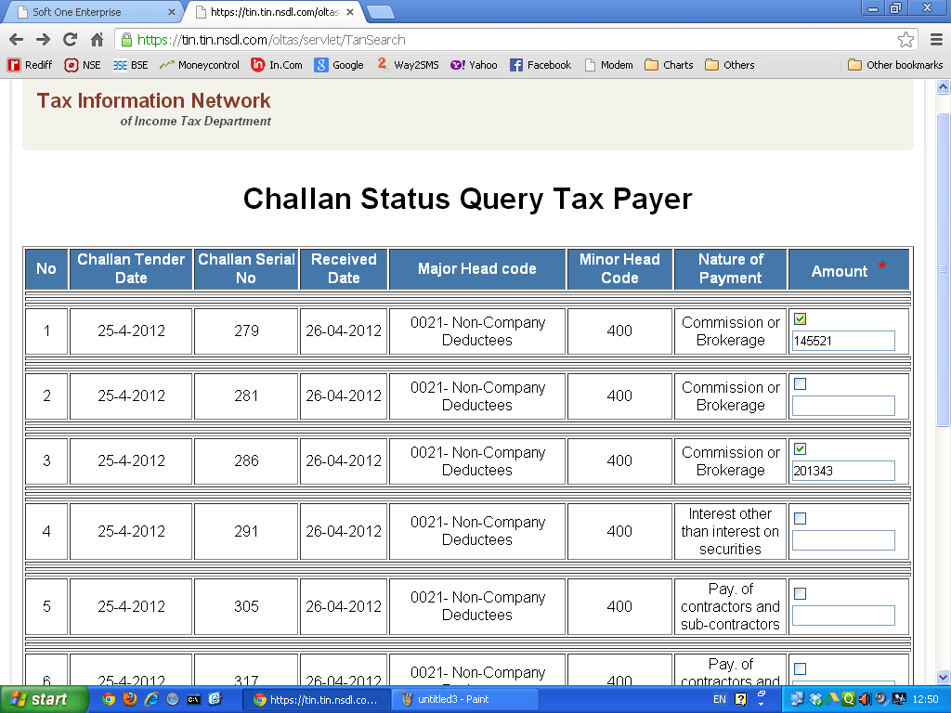
Click on the small box and then enter the respective challan amount in the second box (no decimals).

Slide 11
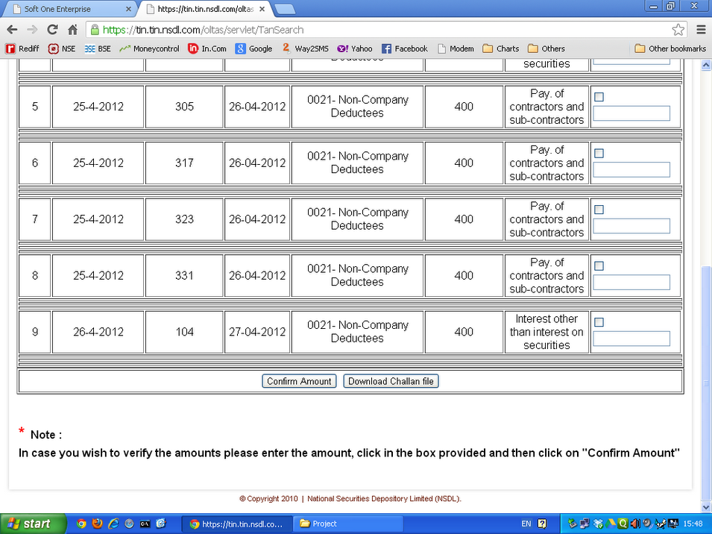
After entering amounts for all the challans, click on this button.

Slide 12
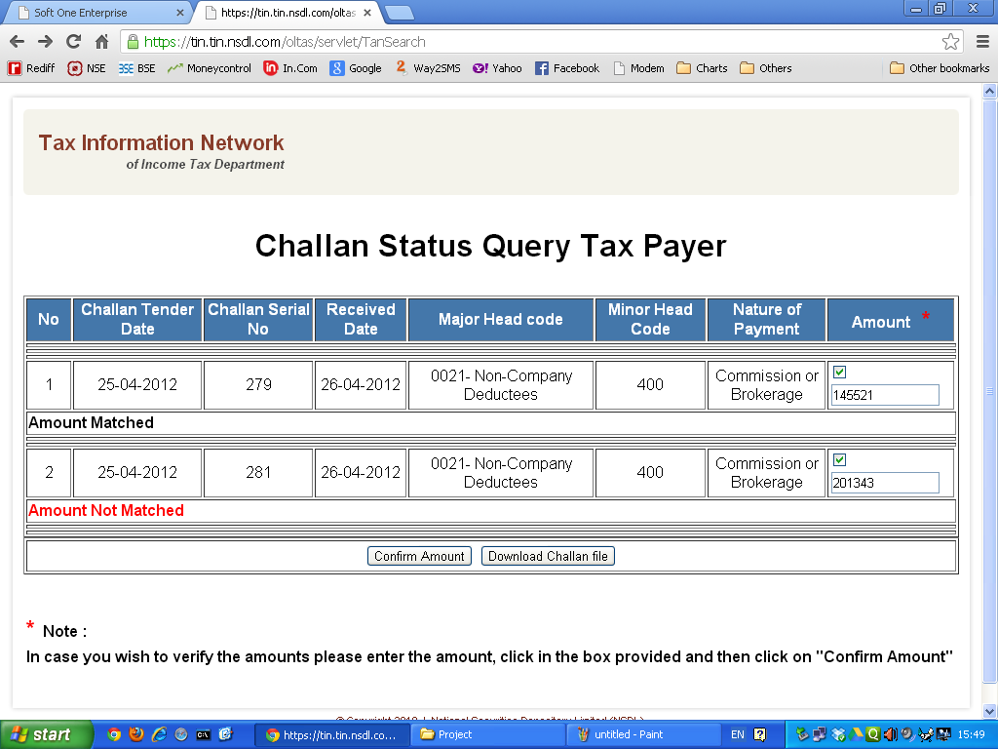
If the amount matches, then it is correct.
If it does not match, check the challan and re-enter the correct amount.
If it still does not match, then follow up the matter with the bank.

Slide 13
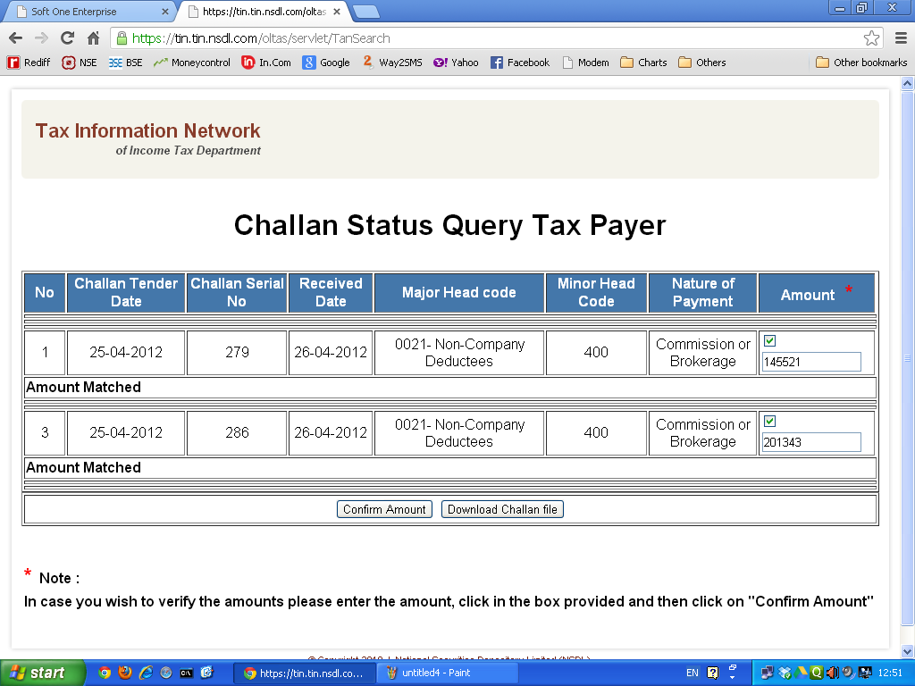
After all the amounts match successfully, click on this button to
download and save the file.

Slide 14

If the "Save As" dialogue box appears as shown in the next screen, then proceed
as shown further.

Slide 15
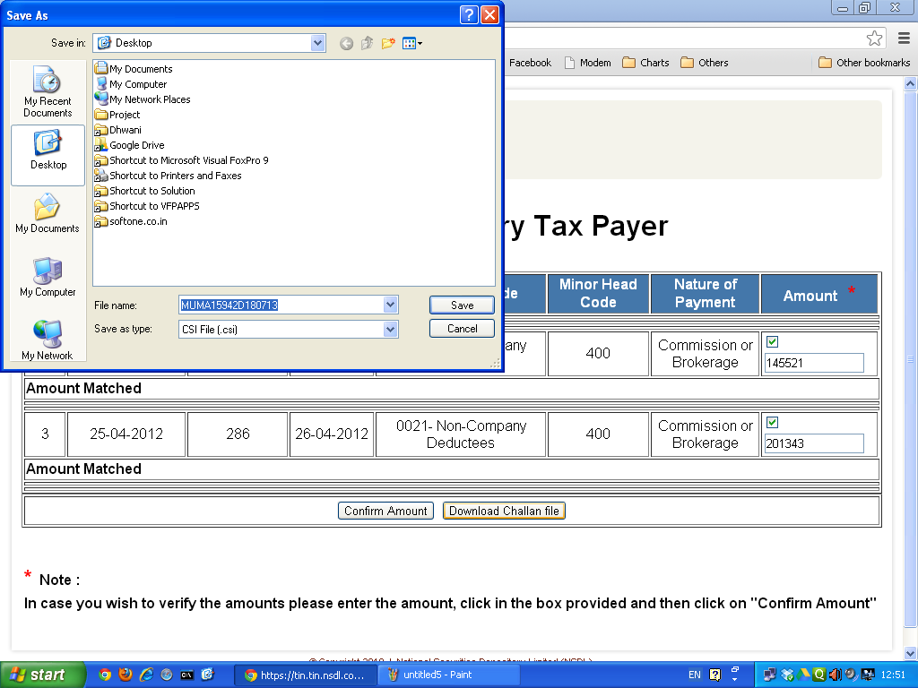
MUMA11111A 180712
Click on
"My Computer"

Slide 16
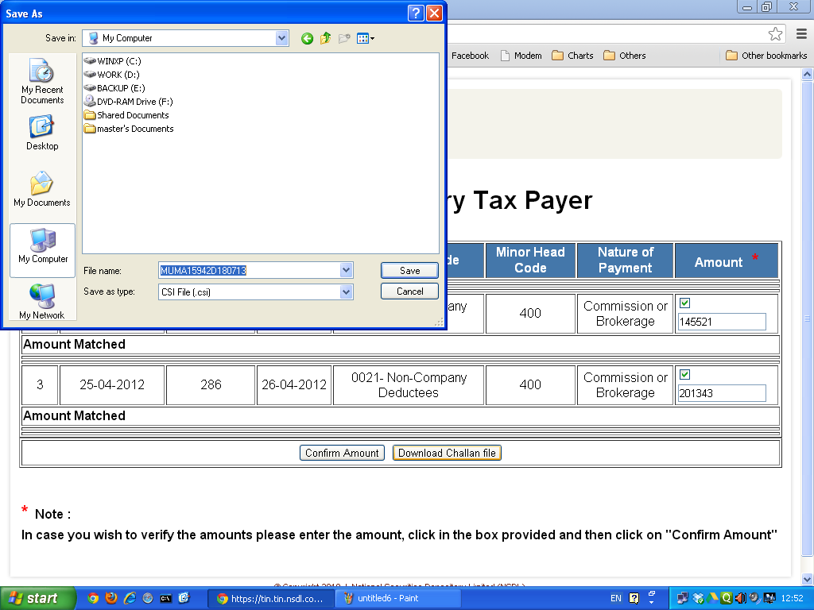
Local Disk (D:)
Double-click on Work Drive (mostly D: or
T:).
MUMA11111A 180712

Slide 17
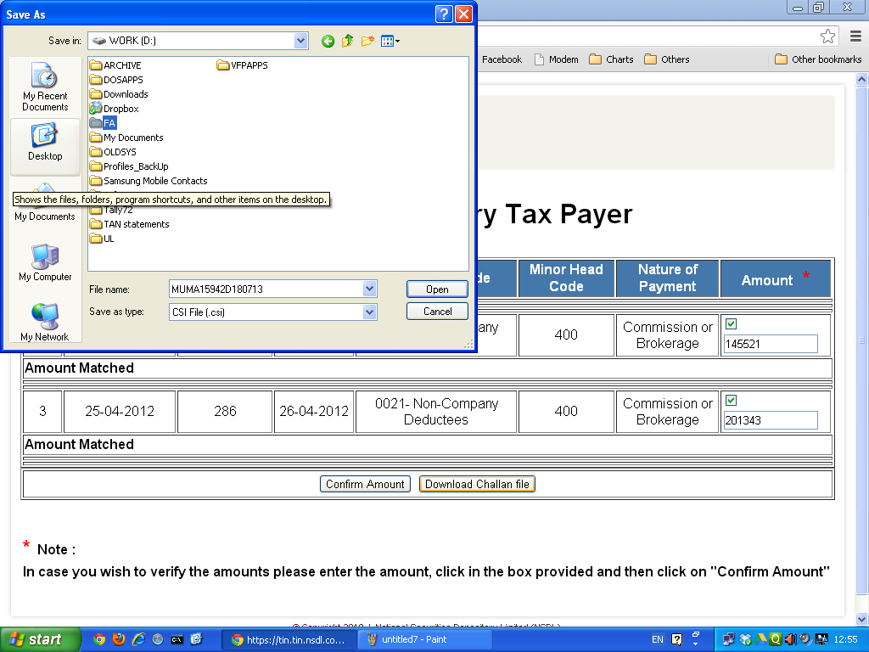
Double-click on
Main Folder (mostly FA).
MUMA11111A 180712

Slide 18
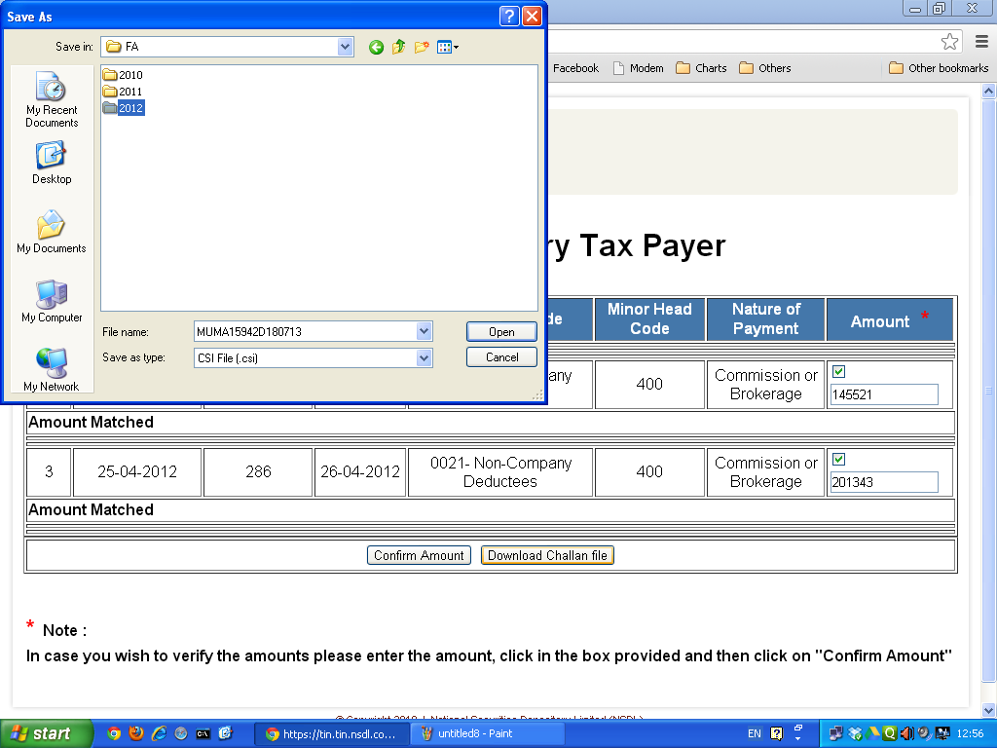
Double-click
on the Year
Folder.
MUMA11111A 180712

Slide 19
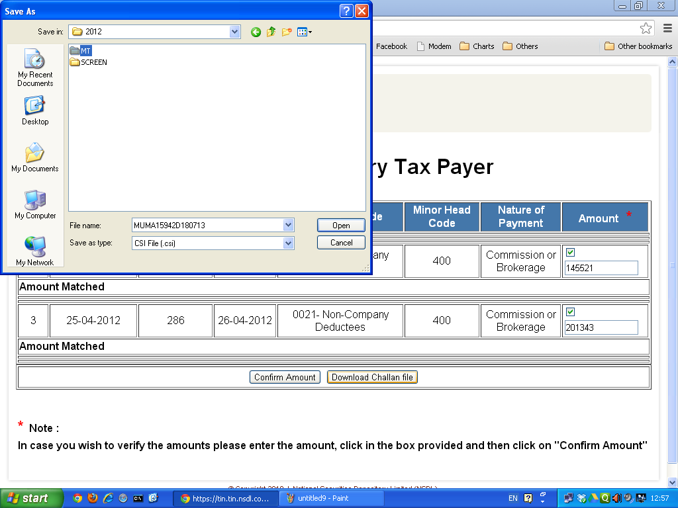
Double-click on
Firm Folder.
MUMA11111A 180712

Slide 20
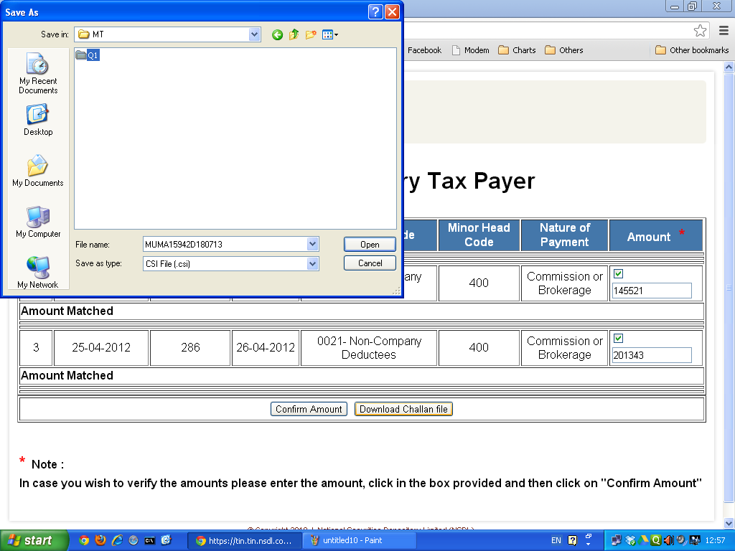
Double-click on
Qtr Folder.
MUMA11111A 180712

Slide 21
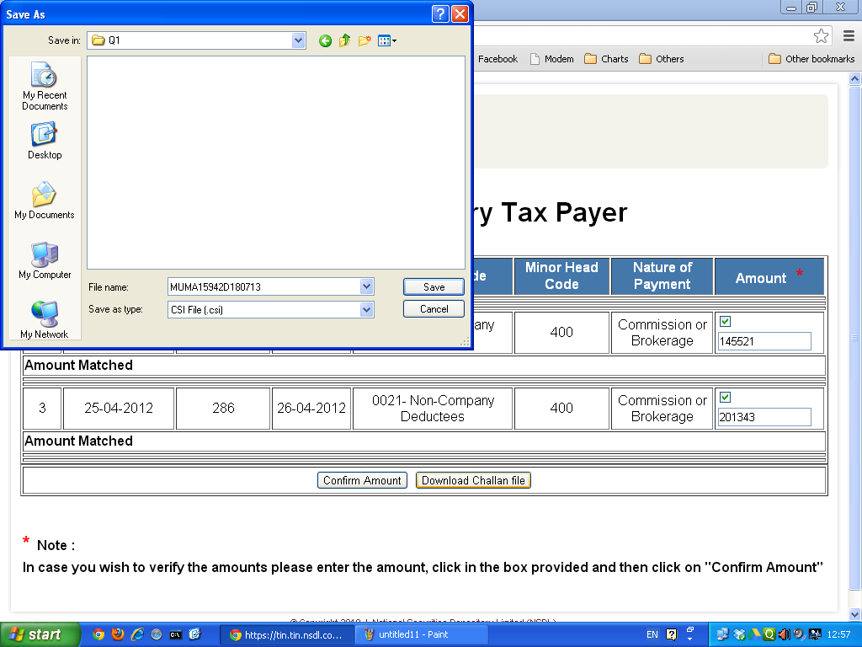
Finally, Click on
"Save" Button to
save the file.
MUMA11111A 180712

Slide 22

If the "Save As“ dialogue box
does not appear, then the
file would have been saved
in "Downloads" folder in "My
Documents" folder.
Follow the steps shown
further to save the file in Qtr
folder.

Slide 23
Go to
--> My Documents >>Downloads
Folder.
--> Right-click on the downloaded
.csi file.
--> Click on "Copy" option.
--> Go to My Computer >> Work Drive
>> Main Folder >> Year Folder >>
Firm Folder >> Qtr Folder.
--> Right-click on blank space.
--> Click on "Paste" option.

Slide 24
End of Slide Show
……..xxxx……..

